Slide 1
COURSE USER FEE WORKSHOP
Presented by:
Business Affairs

Slide 2
Course User Fee Audit
State Auditors review Miami Dade College Course User Fees every two years and may begin as early as November of this year.
All Course User Fees are required to be reviewed at least once every five years.
Manual of Procedures #1164 Course User Fees, depicts the College procedure which outlines the process developed in support of all course user fees.
https://www.mdc.edu/procedures/Chapter1/1164.pdf

Slide 4
Requests to update or delete Course User Fees must be approved according to the following schedule. Please note that all fee changes must be approved by CASSC and entered on the system prior to open registration of any given semester. Therefore, it is very important to turn approved 109 Forms in by the due date noted below to Academic Programs.
Fall Term – April 1
Spring Term – August 1
Summer Term – December 1

Slide 7
LISTING OF COURSES TO AUDIT Review all courses selected for audit listed on the Excel spreadsheet provided by the Office of Business Affairs and distributed by the District Office of Academic Programs. See Example Below:
CRS-ID | EFF-TRM | CRS-TTL | FEE-TY | FEE-TY | FEE-TY | FEE-TY |  | AUDIT DATE
2003-3
CAP2047 | 20033 | USER INTERFACE DESGN | OF10 | VC04 |  |  |  | 10/1/2006
CAP2048 | 20033 | GAME DEVELP PROJECT | OF10 | VC04
CEN1301 | 20033 | SUP MICROSOFT CLIENT | CBE4 | OF08 | OF10 | VC04 |  | 10/1/2006
CEN1304 | 20033 | MAN WINDOWS SERV ENV | CBE4 | OF08 | OF10 | VC04 |  | 10/1/2006
CEN1536 | 20033 | INTRO WIRELESS NTWRK | OF10 | VC04 |  |  |  | 10/1/2006
CEN2306 | 20033 | IMPLEMENTNG DIR SERV | CBE4 | OF08 | OF10 | VC04 |  | 10/1/2006
CEN2320 | 20033 | UPGRADING MCSE SKILL | OF10 | VC04 |  |  |  | 10/1/2006
CEN2321 | 20033 | DES NETWRK INFR DIR | CBE4 | OF08 | OF10 | VC04 |  | 10/1/2006
CEN2537 | 20033 | ADV WIRELESS NETWRK | OF10 | VC04 |  |  |  | 10/1/2006
EXAMPLE

Slide 8
OK, so far we discussed the following: College Procedure #1164 Audit timeline Documentation deadlines So you ask yourself exactly what should the end product be……

Slide 9
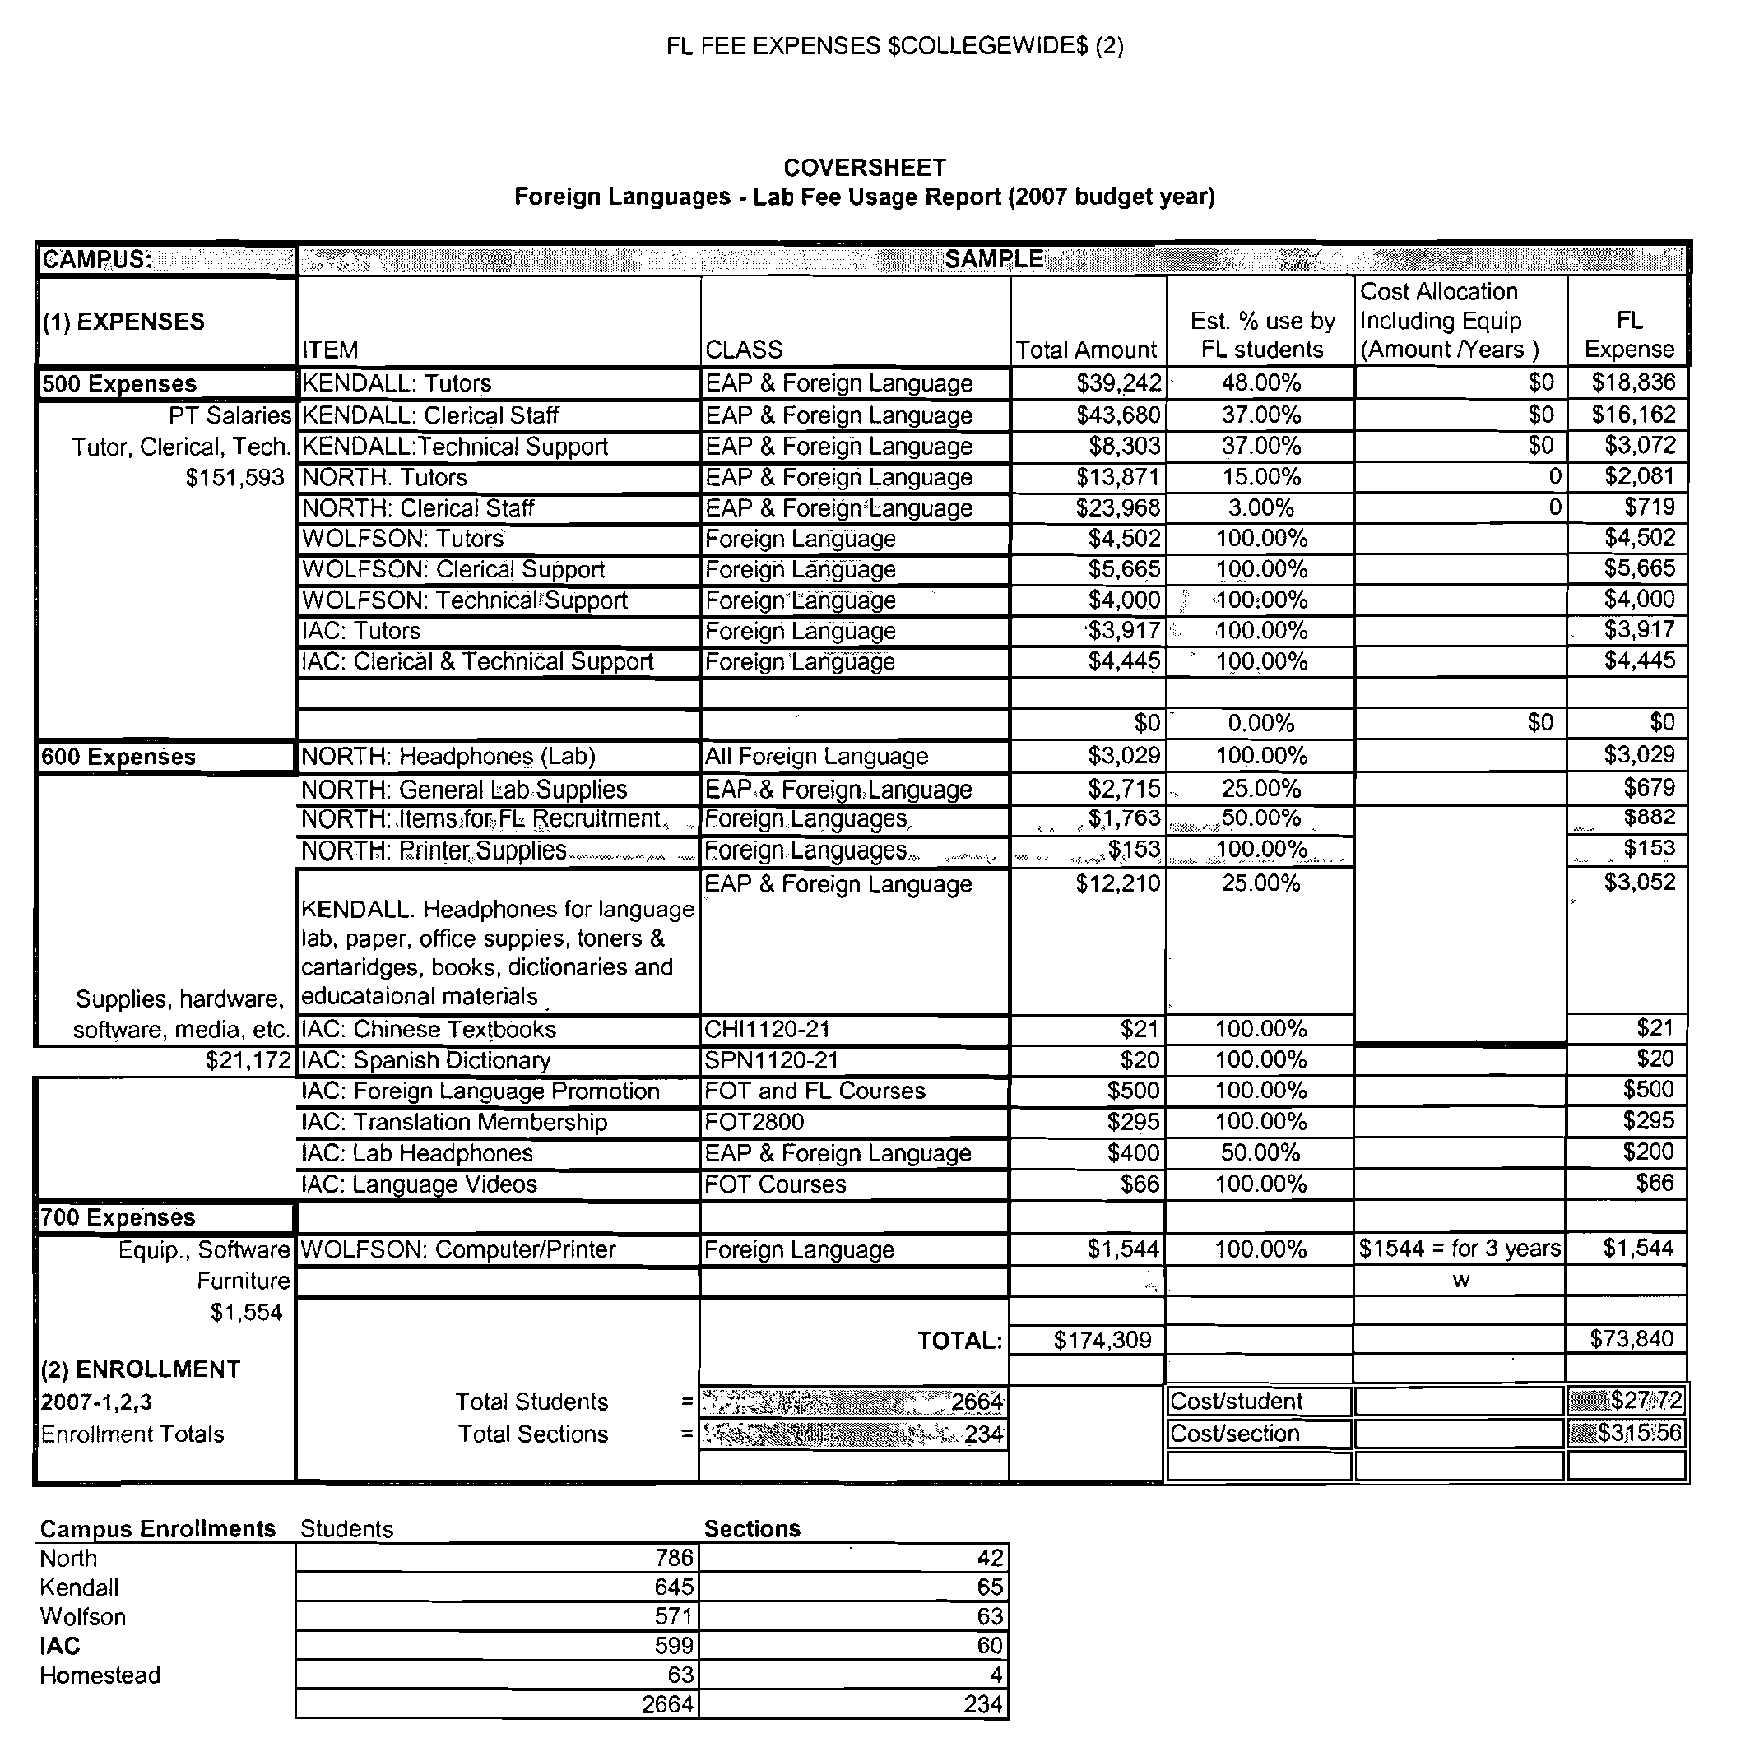
This spreadsheet…

Slide 10
How do you complete the spreadsheet?
Follow the steps on the Special Fees Step by Step Instructions (next page).
This checklist was created to help you gather all of the data needed for the fee audit process.
The spreadsheet was created with formulas to support the cost calculations.
The checklist and spreadsheet are both available on the college’s website, under forms in Business Affairs, in the Odyssey section.
https://www.mdc.edu/businessaffairs/FMs.asp

Slide 12
Completing the checklist and worksheet developed provides a systematic process to document costs and minimize errors: Step 1. Campus where courses are held is easy to identify. Step 2. Course ID and Reference # is very important to obtain so the quals where the courses and course expenditures are held can be determined. If you follow the path noted on the checklist (OD, ST, CAMPUS #,CU, CC, MC and reference #, enter, type “D” on action line and tab to reference # press enter), you will get the information needed as illustrated on the next page.

Slide 14
Every course reference number is attached to a qual. Therefore, you will need to check all of your reference numbers to make sure you capture all of the quals. You may have one qual or many.
Also remember that some expenses may be in your Department Chairs qual instead of the qual used for the course. Please check with your Department Chair to obtain this information.
This can be a little confusing, but once you have identified the quals all of your expenses will be easy to locate.

Slide 15
Something to remember, you cannot use expenditures which are funded by Grants, Fund 2 (e.g., Perkins) to support the fee calculation.

Slide 16
Step 3. What is furnished and or provided for the student? You must identify and document course related expenses supporting the fee. This includes cost components which are not direct instructional and are provided or available to the student. Cost components may include equipment (computers, monitors, video and audio equipment, vehicles etc.), instructional materials (copies, software, etc.) personnel (tutors, staff, paraprofessional) or supplies (paper, fire arms, special gear, fuel, medical supplies etc.). Cost information and data documentation include payroll records, invoices, purchase orders and purchasing card reconciliations.

Slide 17
So now you ask yourself where do I get all of this information?
1. Payroll records are all in OD. Follow the path of CM, TA, EA, type in check date, H (hourly), qual and enter.
2. Finance records are all in OD. Follow the path of CM, IQ, IP, IS, type qual and enter.
3. Computer/Equipment all inventoried items are in the Property Management System that you can accessed via the web.
Next few screens will guide you through the system…

Slide 18
Payroll Records OD CM TA EA
.

Slide 19
From the prior screen if you press F11, you will get the information noted above, the hourly rate.

Slide 20
Personnel cost is an expense component often overlooked and includes expenses generated from courses and/or labs including lab assistants or tutors.
By using the screens just reviewed you can capture all of the personnel cost to complete this section of the worksheet.

Slide 21
Finance Records
In the Finance area the following transactions are posted:
Purchase Orders
Disbursement Requests
Purchasing Card
Follow the path of OD,CM, IQ, IP, IS type qual and enter. This brings you to the Income and Expense screen.

Slide 22
Remember that accounts beginning with 5’s are related to personnel expenses. The data here is for transactions posted in June 2008. If you need to go backwards in time, just type over the year and month.

Slide 23
PO’s/ Invoices
Again same as the previous page, but more general ledger codes are displayed for the qual, after pressing the F8 key. If you scroll to the general ledger code and press enter, more detail information is provided.

Slide 24
PO’s/ Invoices
This screen displays the PO’s paid under the general ledger code 65501. The type code indentifies the type of transaction. By typing “D” [Display] on a line, you can get the detailed information of the transaction.

Slide 25
PO’s/ Invoices
This screen provides additional detailed information on the account payable expenditure after you display the line item.

Slide 26
Example of a Disbursement Request, same screens, OD, CM, IQ, IP, IS, type qual and enter, F8 to scroll to next page, scroll to GL code, tab to Actual column and enter.

Slide 27
This screen displays the line item from the prior screen. Tab to action line and type “D” and enter.
Disbursement Request

Slide 28
If you display the line item you get a description of the transaction, this one was a disbursement request.
Disbursement Request

Slide 29
Purchasing card transactions can be viewed the same way, OD, CM, IQ, IP, IS, type qual and enter. Scroll to GL code and Actual column, enter.

Slide 30
Here the line item is displayed. If you type “D” on action line and enter.
P-Card Transaction

Slide 31
The transaction information is fully displayed. Remember that Purchasing Card transactions are posted as JE’S.
P-Card Transaction

Slide 32
Property Management System
All college property over $1000.00 and all computers are tracked on the Property Management System.
All college employees that are A1’s or A2’s have access to view inventory via the web.
PC labels are placed on all computers and recorded under the department qual.
http://webftp2/dhsweb/

Slide 33
Property Management System

Slide 34
Step 4. Number of students per class/sections.
This data can be obtained from a number of places including the class roster within Odyssey or enrollment data from the EIS system or other IR data reports. This will be the final data element compiled to complete the spreadsheet.
https://eisvsr.mdc.edu/eis/gate/EISmain.aspx

Slide 35
Once you are in EIS, select your term from the left hand side, and the next screen appears.

Slide 36
Scroll to Headcount by Credit Type Manager, enter. Also Class Rolls has this information.

Slide 37
This screen appears, scroll to the campus needed and enter.

Slide 38
Once you press enter, the following screen appears, select credit and enter.

Slide 39
Search for your area and the total registered for the year is displayed.

Slide 40
Step 5. Justification of Cost.
A spreadsheet was developed to provide a systematic process to compile your data and calculate cost components.
A number of formulas are included to support the cost calculations.
This spreadsheet must be turned in with all of your supporting documentation.
The next screen displays a blank copy of this spreadsheet.
https://www.mdc.edu/businessaffairs/FMs.asp

Slide 43
After the data components are inputted into the spreadsheet, formulas will calculate and generate a per student fee/cost which should be equal to or more than the special fee currently charged.
If the current fee being charged is greater than the cost per student, review all cost components to be certain a cost element was not overlooked.
In the event no additional cost elements are identified you must revise the current fee and decrease it to correspond with the calculated fee.
MDC cannot charge more than what is supported by the data compiled.

Slide 44
http://www.mdc.edu/asa/documents/109FeeForm.doc
The next screen displays a copy of a completed CASSC 109 form.
Please make sure you are using the current version of the CASSC 109 form since it has been revised to include the appropriate signatures.
Complete a CASSC 109 form reflecting the calculations.
The CASSC 109 form can be found under the Academic Programs website:

Slide 46
Please forward the signed CASSC 109 form with the cost justification spreadsheet and all supporting documentation to Greg Knott, Business Affairs, Kendall Campus, Room 1130.
Business Affairs will review and upon approval, will forward a copy or the original of the approved CASSC 109 form to the Department Chair so they can proceed to take the form to their Academic Dean for the next ALC and CASSC meetings.
Business Affairs will also advise the District Office of Academic Programs of approvals and will scan all supporting documentation for storage of records.

